Slide 1
Web Phase Two
Project Update and Next Steps
Russ Pearlman
Division of Information Technology
October, 2023

Slide 2
my.creighton.edu
ASSESSMENT

Slide 3
User collaboration
INTERVIEWS
  10+ faculty interviewed
  20+ staff interviewed
  10+ students interviewed
  Both Omaha and Phoenix campuses represented
CONTENT WORKSHOPS
  HR , mission, EDI (5+ participants)
  Student life (5+ participants)
  Enrollment management (5+ participants)
  Faculty (10+ participants)
  Administrative assistants (8+)

Slide 4
Select Feedback
“We have our own SharePoint, so there’s a lot of duplicative efforts. There’s a lot of confusion.”
— HR Specialist
“I can’t find 80-percent of the content I need within a couple of clicks; the other 20-percent I have no idea where to find.”
— Department Chair
“The site doesn’t represent what we want users to see. It tends to make things difficult and doesn’t show the vibrancy of Creighton.”
— Department Chair
“It’s not just having access to all the different links we need. It’s about having it personalized and customized so it’s clear what applies to me.”
— Student

Slide 5
Common Themes
USERS CAN’T FIND WHAT THEY NEED
  Various and outdated versions of the same page are still live
  Bookmarks no longer working
  Search is ineffective
CONTENT IS NOT ORGANIZED OR PERSONALIZED
  Inconsistent formats
  Unclear how content is loaded to the website or “internal” vs. “external”
  Content is not tailored to my individual needs, location, etc.
IT DOESN’T FEEL LIKE CREIGHTON
  No experience of a community or reflection on who we are
  Key features such as directory of people and departments is missing
  Need easy access to resources and helping navigate our complex organization

Slide 6
my.creighton.edu
VISION AND DESIGN

Slide 7
Overarching Needs
WE NEED TO “START FRESH” ON OUR CONTENT
  Organized
  Standardized
  Managed
WE NEED TO MAKE CONTENT MORE ACCESSIBLE
  Effective searching capabilities (filters and facets)
  Specific ways to search departments, people, and across resources (e.g., SharePoint)
  Focus on personalized user tasks, not how we are organized
WE NEED TO SHOWCASE CREIGHTON
  Consistent experience
  Access to resources, tools, and community
  A user experience reflective of our brand and personality

Slide 8
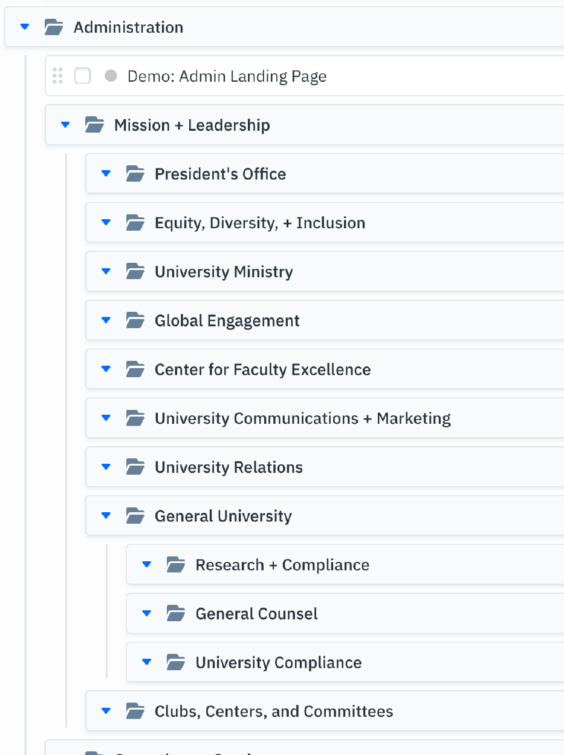
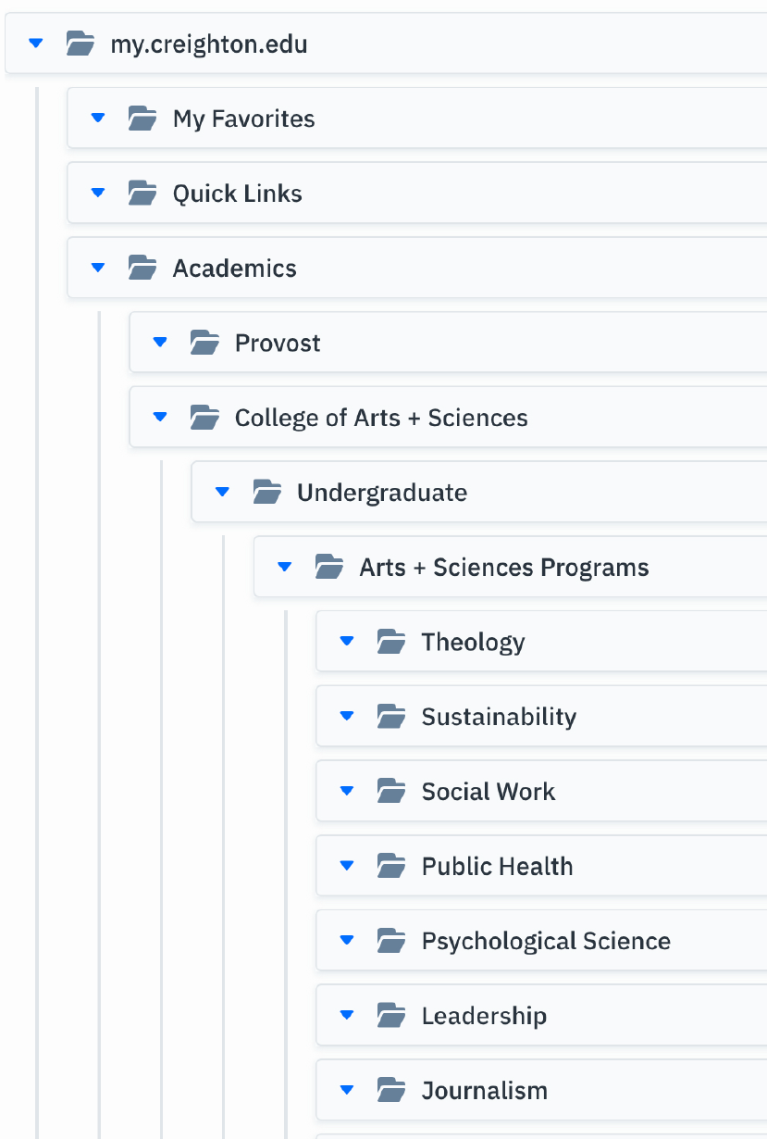
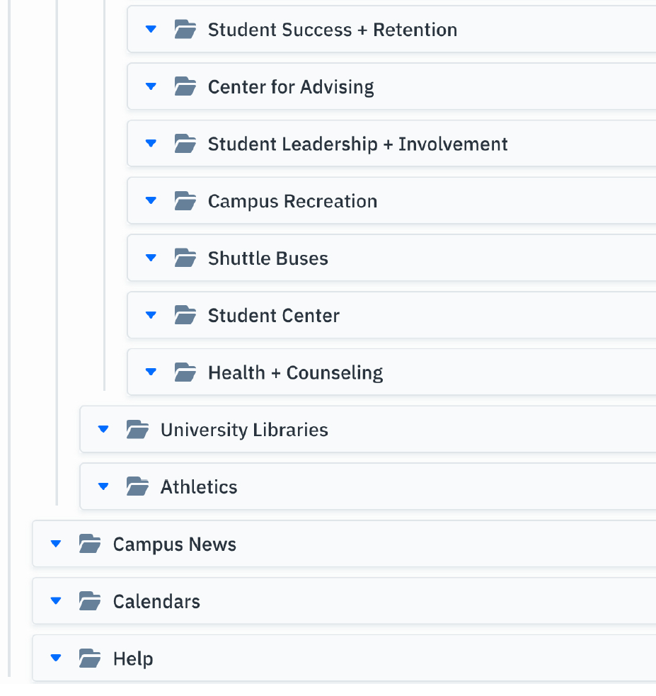
Content Outline: Hierarchy

Slide 9
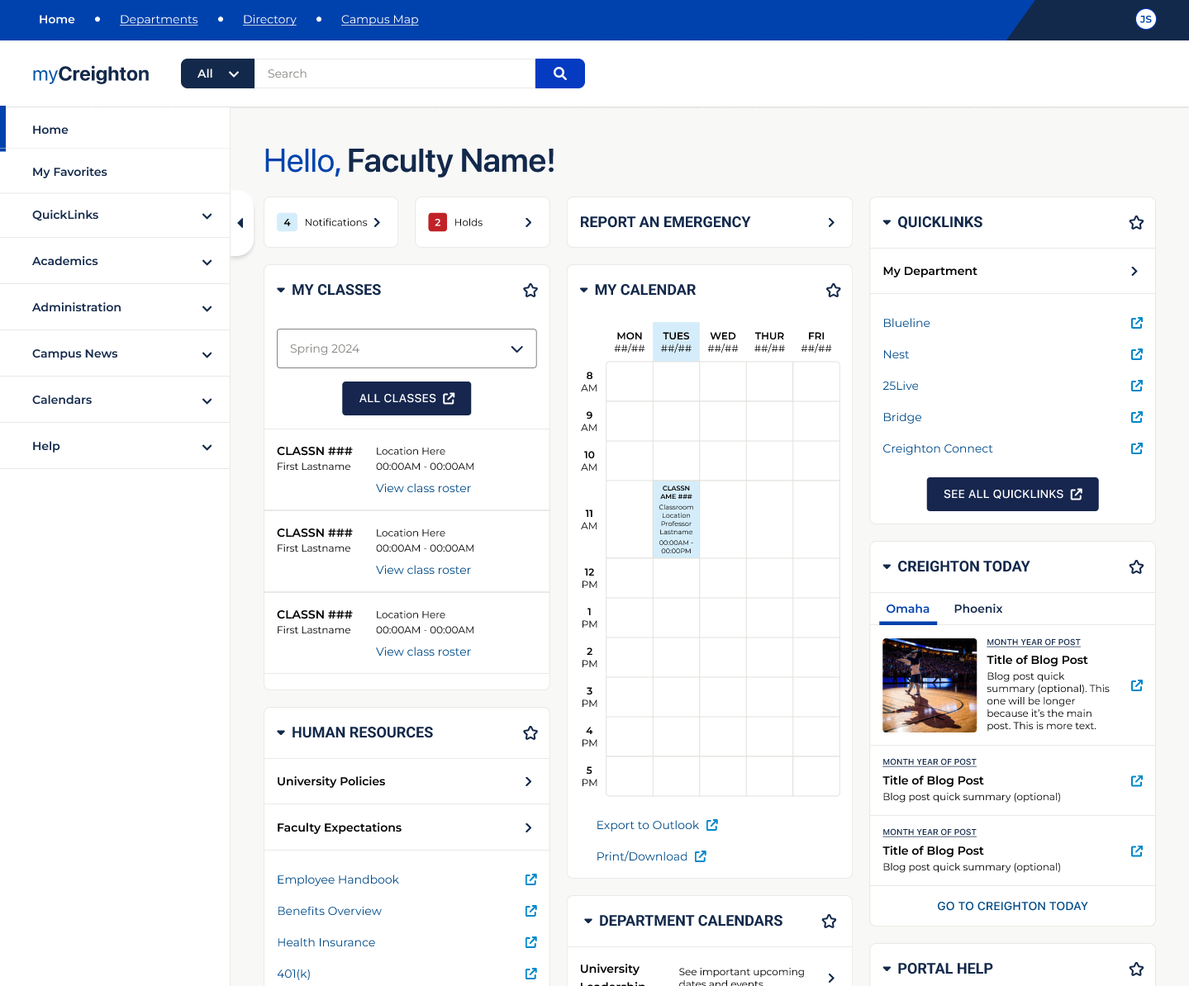
Content Outline: Homepage (Faculty)

Slide 10
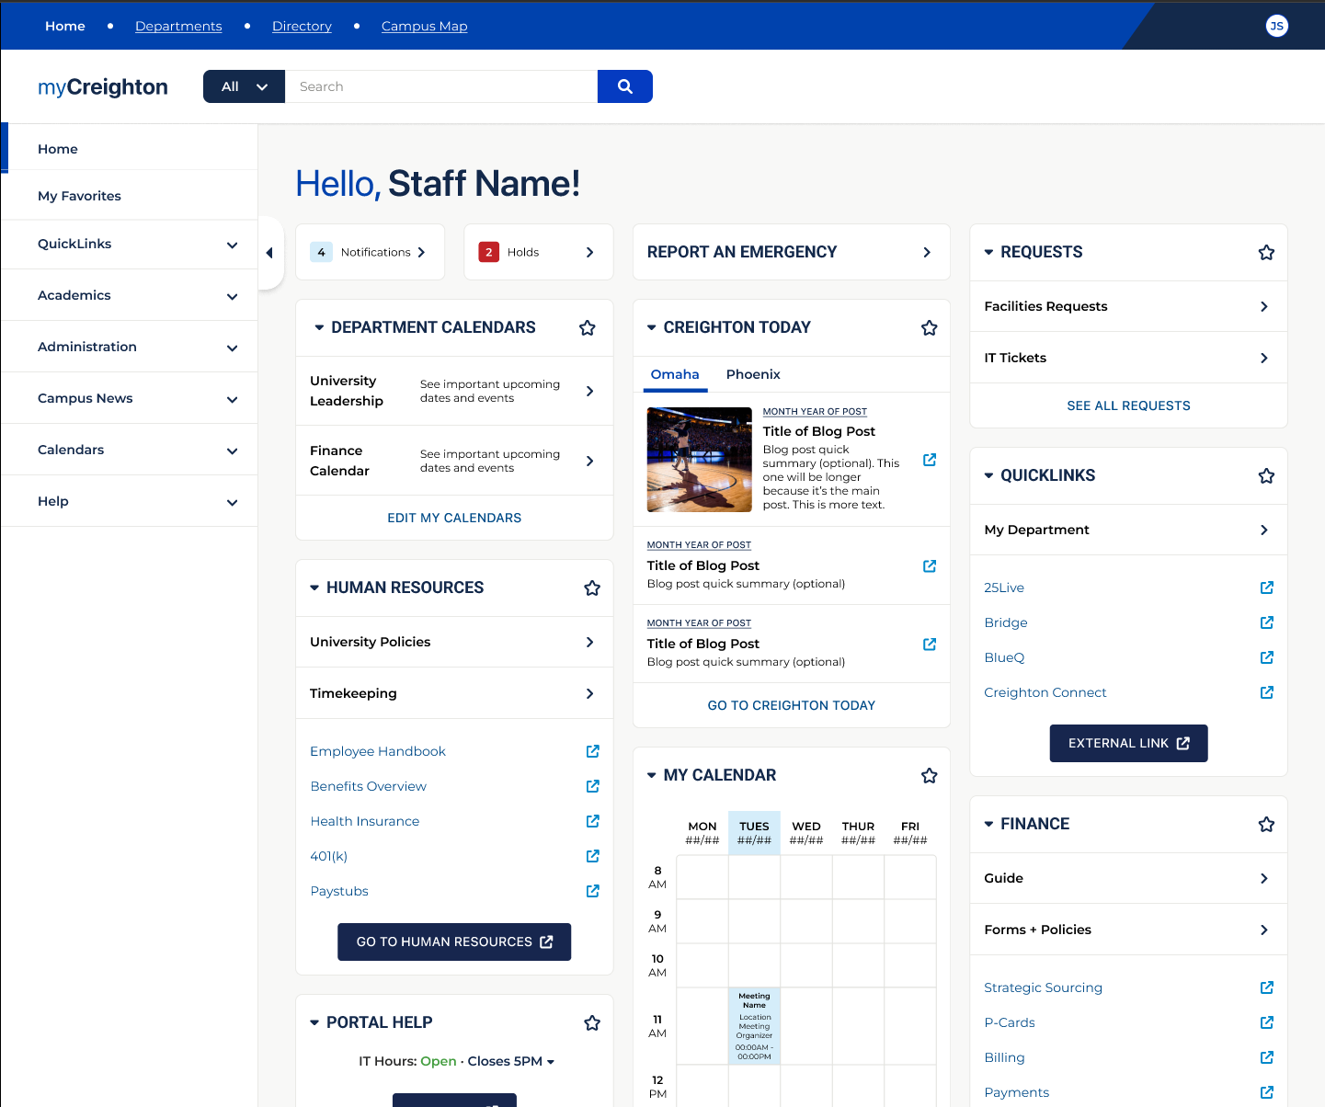
Content Outline: Homepage (Staff)

Slide 11
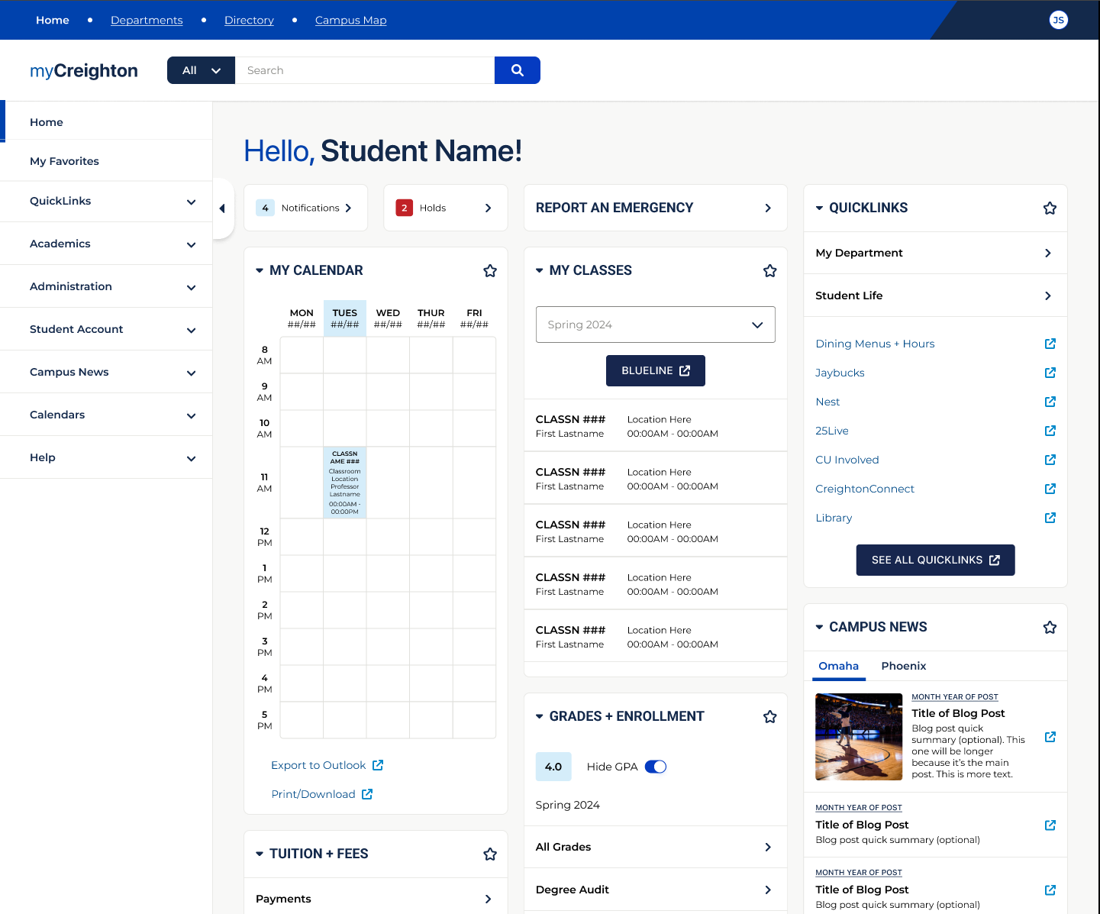
Content Outline: Homepage (Student)

Slide 12
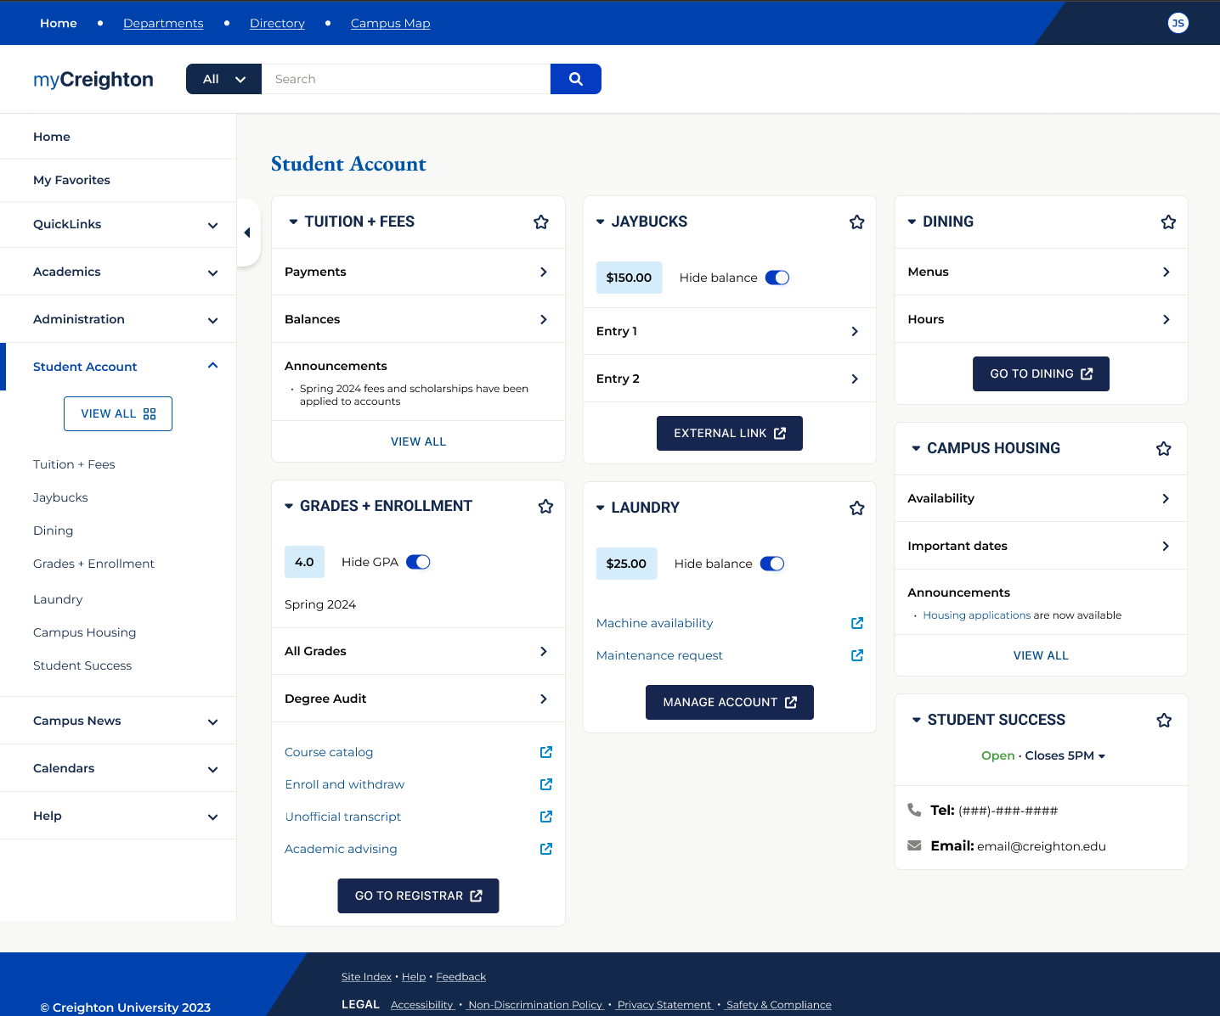
Content Outline: Account (Student)

Slide 13
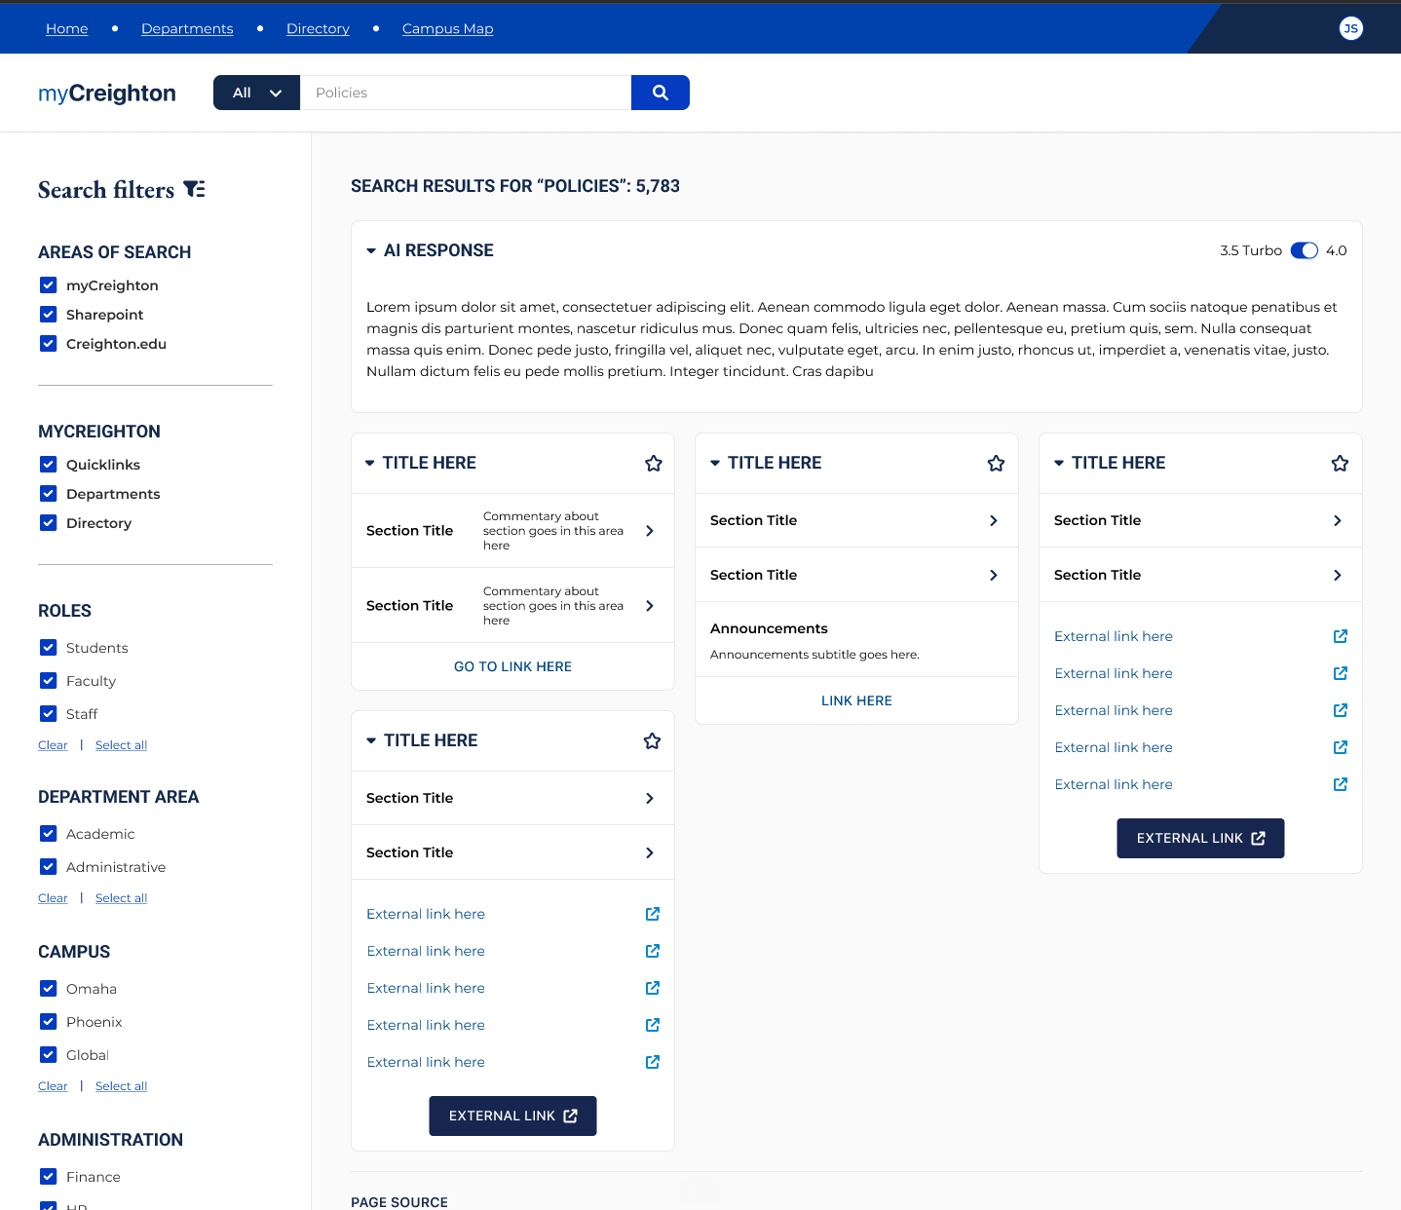
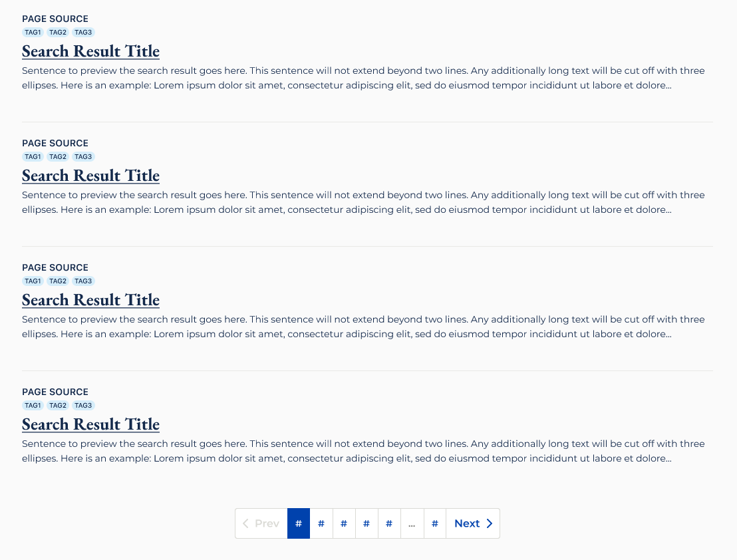
Content Outline: Search

Slide 14
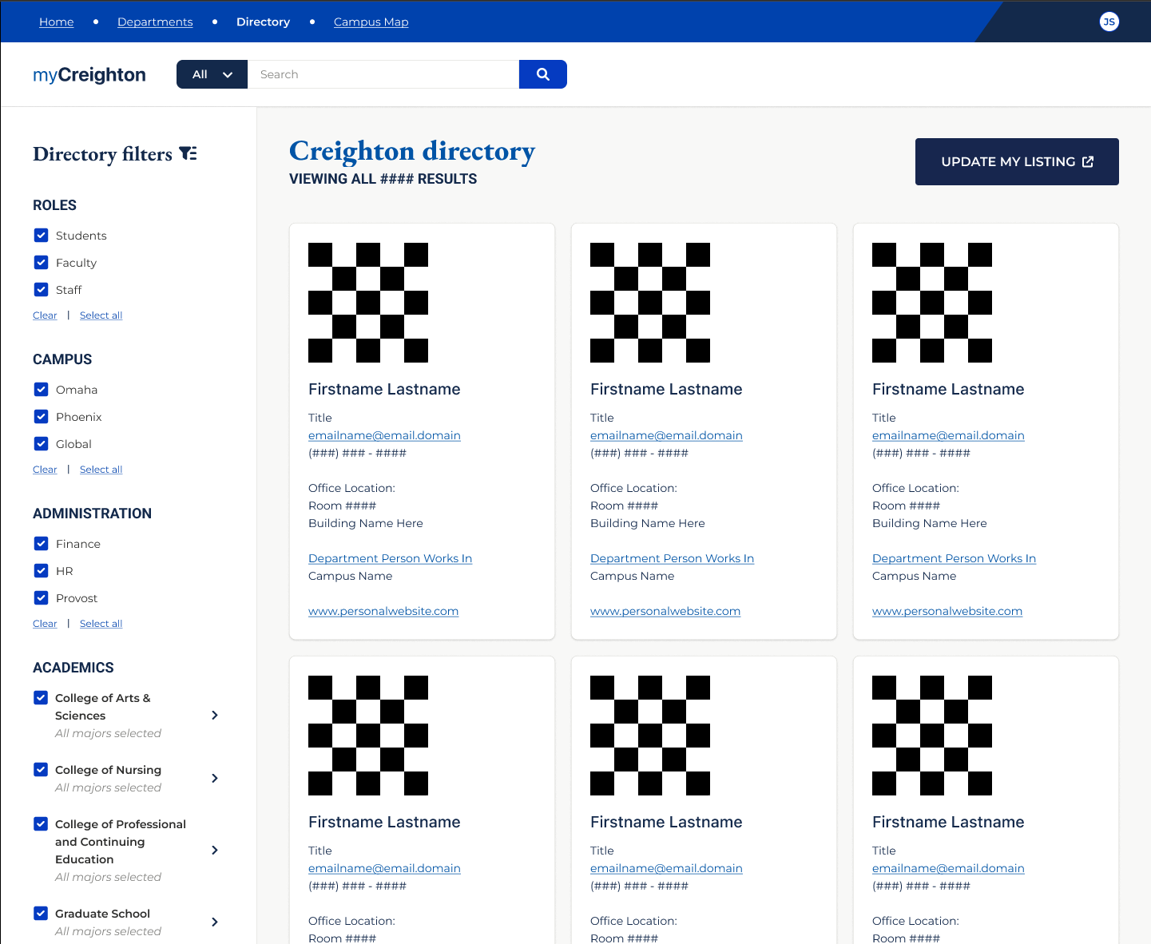
Content Outline: People
Search

Slide 15
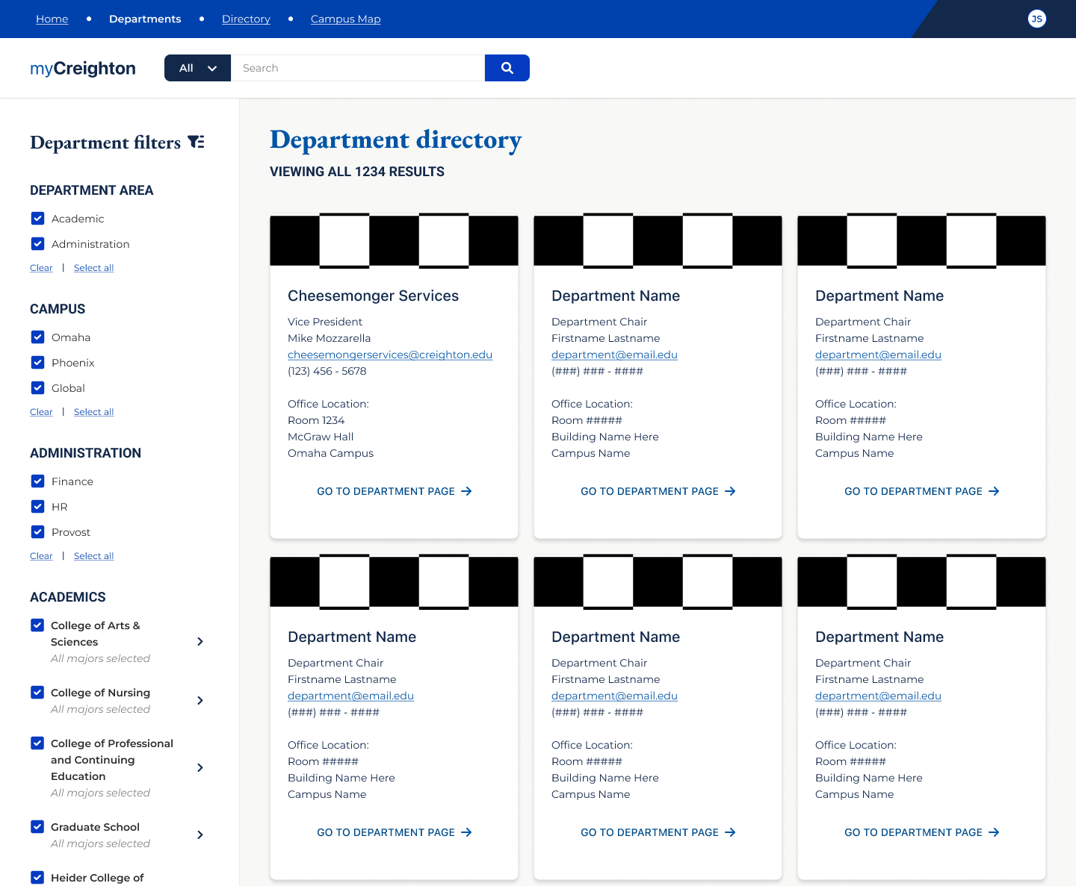
Content Outline: Derpart-ment
Search

Slide 16
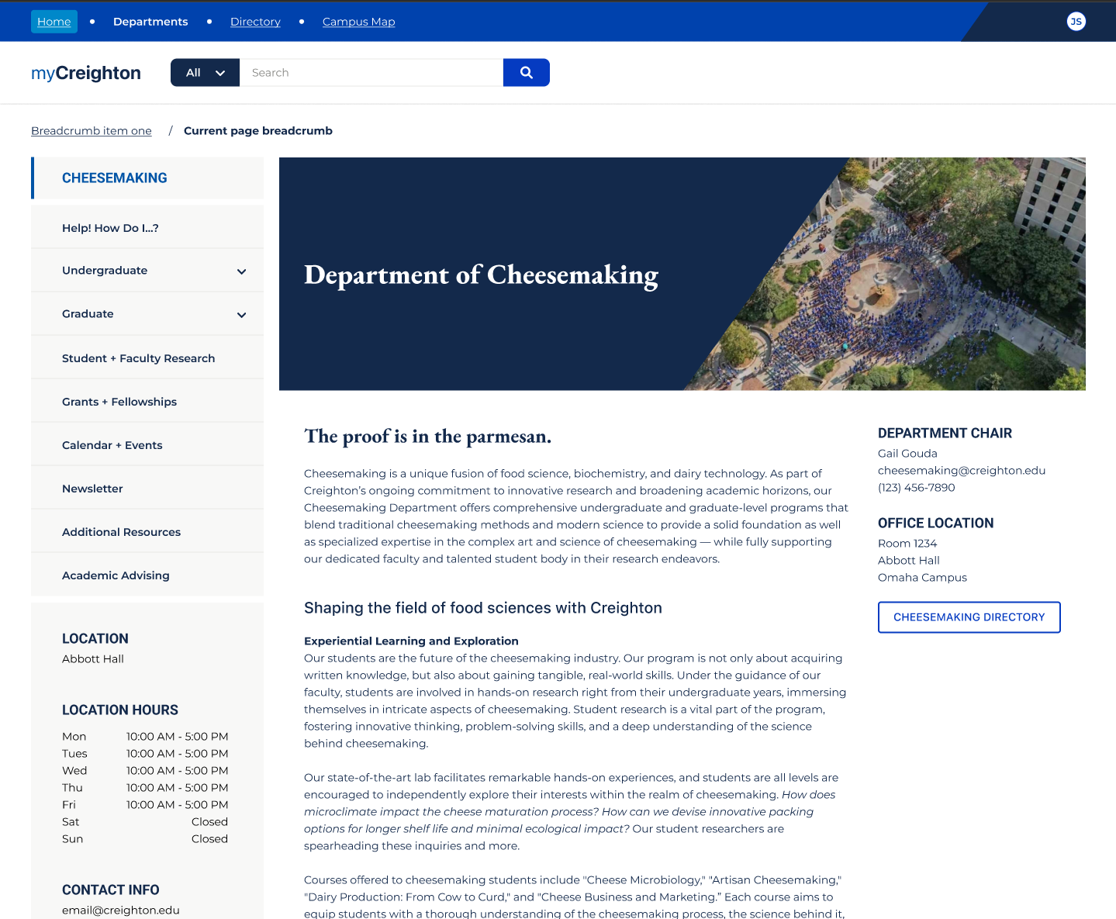
Content Outline: Depart-ment

Slide 17
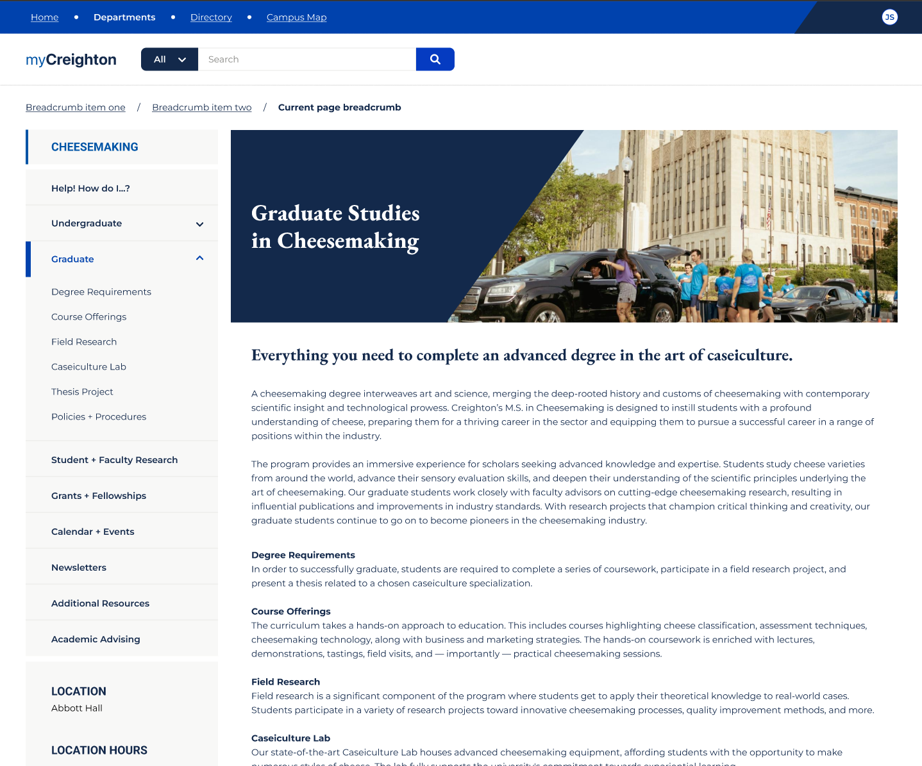
Content Outline: Depart-ment
(Sub-page)

Slide 18
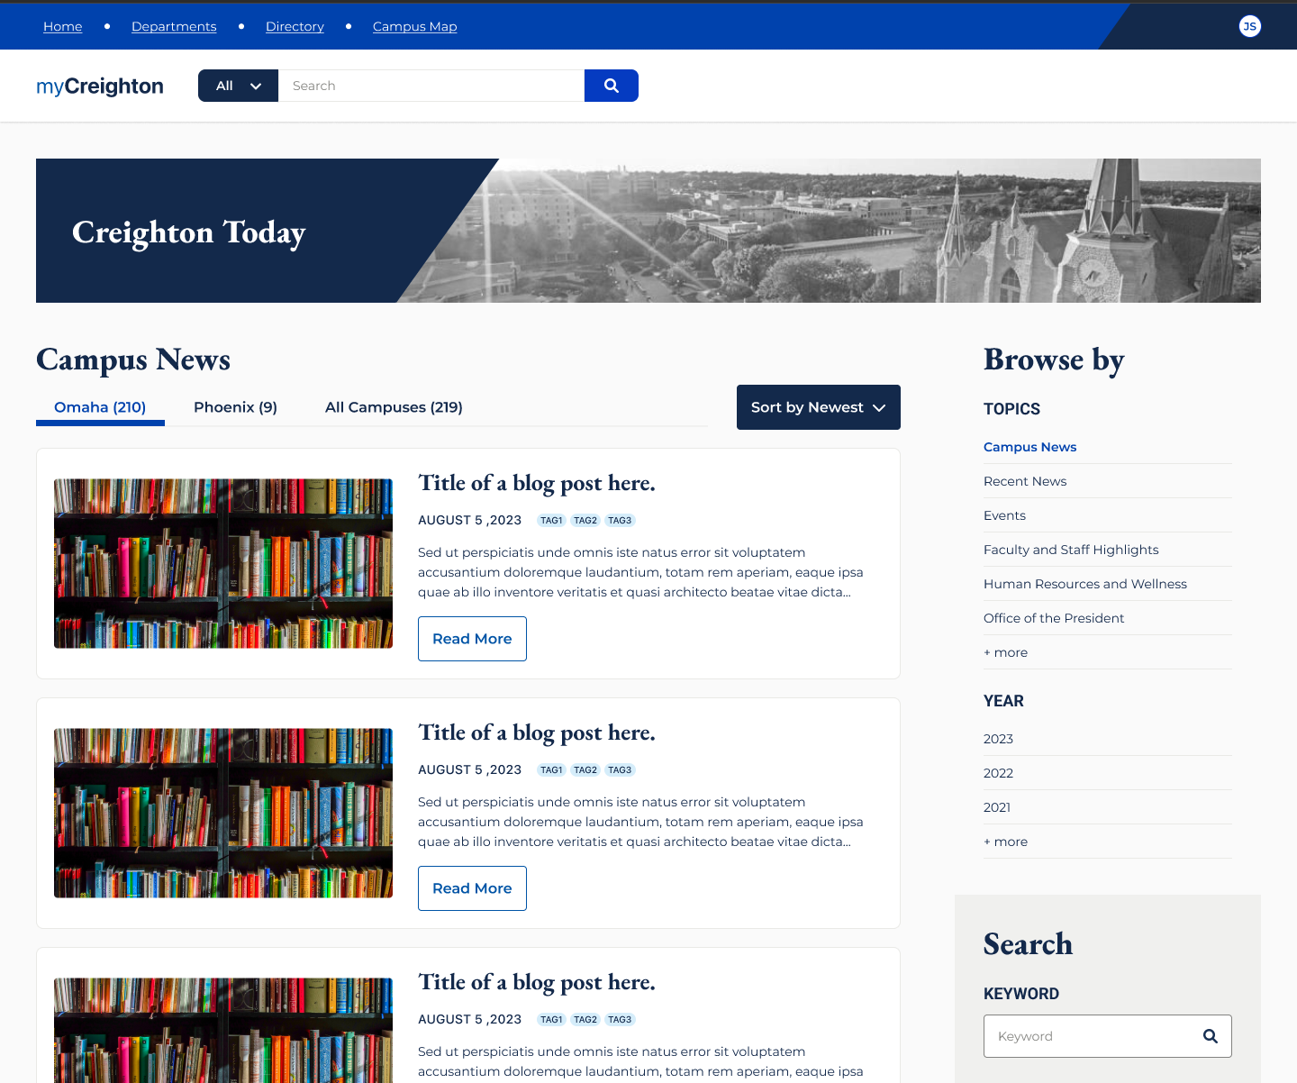
Content Outline: Creighton
Today

Slide 19
my.creighton.edu
NEXT STEPS

Slide 20
Next Steps
COLLABORATION AND FEEDBACK
  Engagement with various campus groups
  Opportunities to learn more and engage
CONTENT COLLECTION (STARTING NOW THROUGH SPRING)
  Utilize GatherContent.com from various campus stakeholders
  Templates, facilitated review, and iterative enhancements
FURTHER TECHNOLOGY BUILD OUT
PREPARING FOR LAUNCH (SPRING) & POST-LAUNCH
  Critical mass of content and capabilities
  Ongoing content management / delegation
  Enhancements (personalization, features, etc.)

